Slide 1
LightGBM Algorithm

Slide 2
Light Gradient Boosting Machine-LG BOOST
LightGBM is most featured by its faster training efficiency and great accuracy.
Special techniques are:
Gradient-based One-Side Sampling(GOSS)
Histogram Based Best Value Search in Tree Node Splitting
Exclusive Feature Bundling
Leaf-wise Tree Growth Strategy

Slide 3
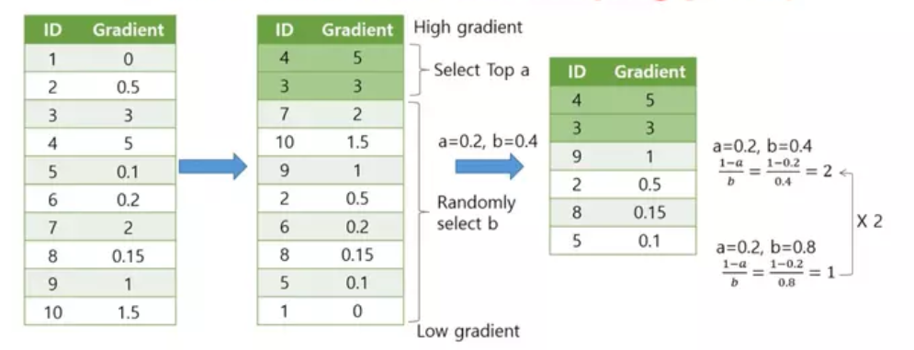
1.Gradient-based One-Side Sampling(GOSS)

Slide 4
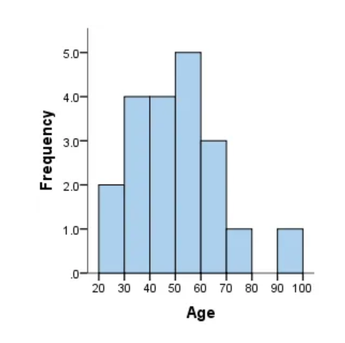
2. Histogram Based Best Value Search in Tree Node Splitting
LightGBM splitting criteria is to reduce gradient variance from parent to children.
For example, given the below age feature, histogram discrete feature values ​​into different range bins, so we can use spiting criteria like Age⩽30, Age⩽40, , , Age⩽100 instead of trying all the possible age value like Age⩽31, Age⩽32 etc.
Parent Node Histogram = Left Child Histogram + Right Child Histogram

Slide 5
3.Exclusive Feature Bundling
EFB aims to reduce features by merging features, specifically, merge the mutually exclusive features, which rarely take non-zero values ​​at the same time.
LightGBM provides the below two algorithms to implement
Identify mutually exclusive feature bundles from training set
Merge feature bundle and assign a value to the bundle

Slide 6
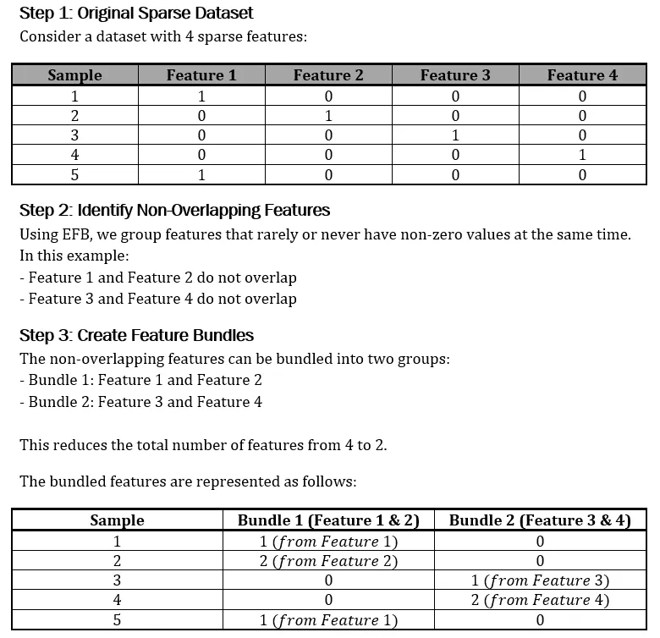
Steps for EFB

Slide 7
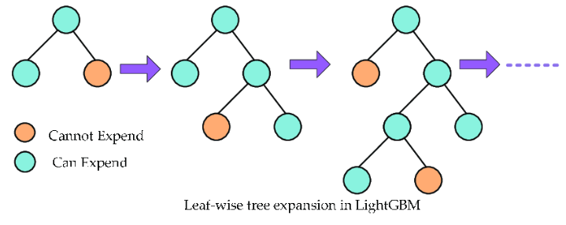
4.Leaf-wise Tree Growth Strategy

Slide 8
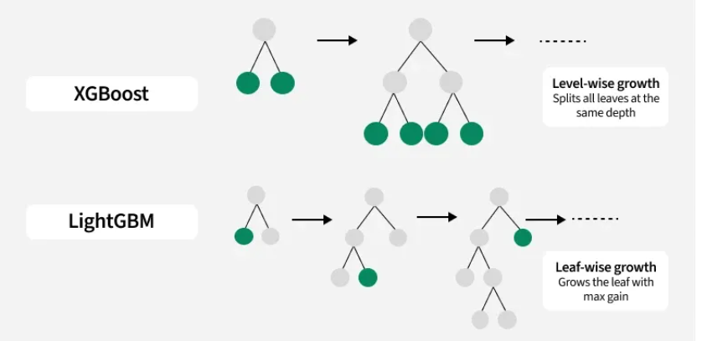
Difference b/w XG and LG BOOST

